Slide 1

Notes:
Hello, and welcome to the CMP Training Workshop. My name is Emma, and I will be guiding you through the basic concepts and work flow of the CMP batch operations module.

Slide 2
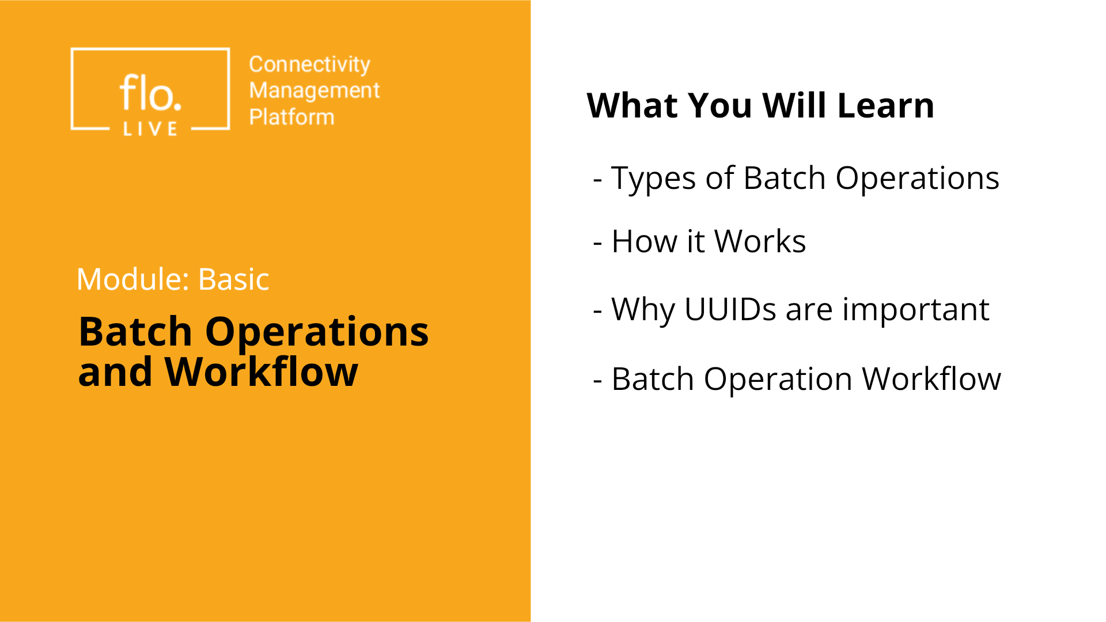
Notes:
In this session, we explore the key concepts and different types of batch operations. You will learn about the importance of UUIDs followed by a step‑by‑step guide of the batch operation workflow. Lets get started.

Slide 3
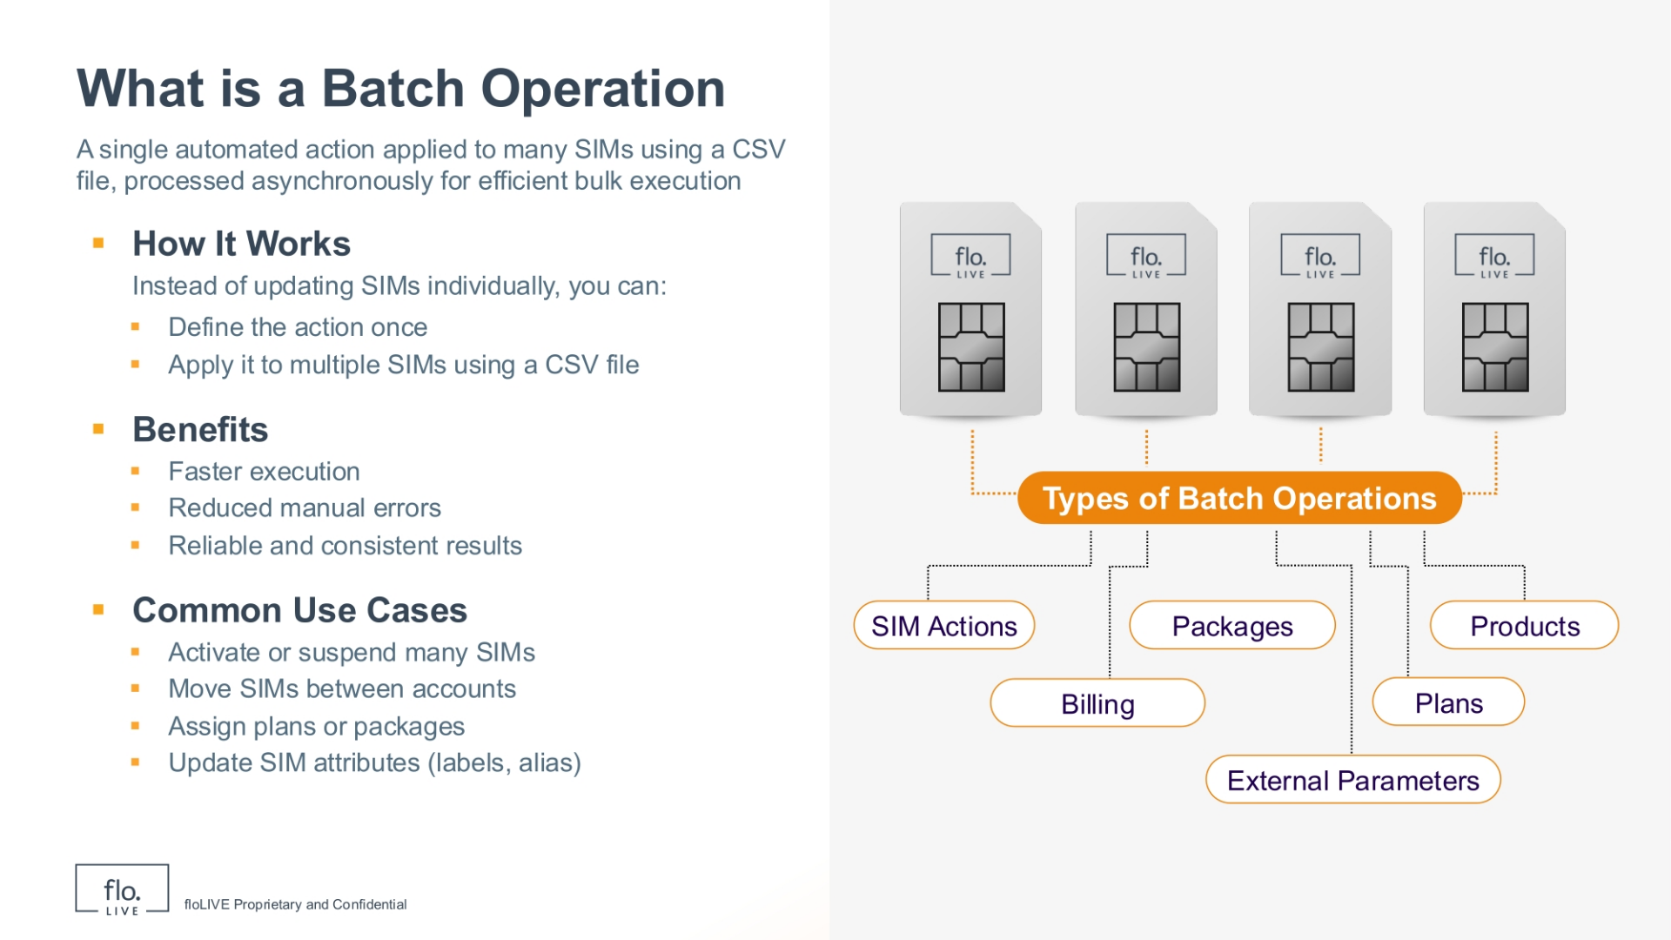
Notes:
A batch operation is a single action applied to many SIMs using a CSV file. Instead of updating SIMs one by one, you can define the action once and apply it to many SIMs. This saves time, reduces errors, and delivers reliable, consistent results. Common use cases include activating or suspending SIMs, moving SIMs between accounts, assigning plans or packages, and updating SIM attributes like labels or alias.

Slide 4
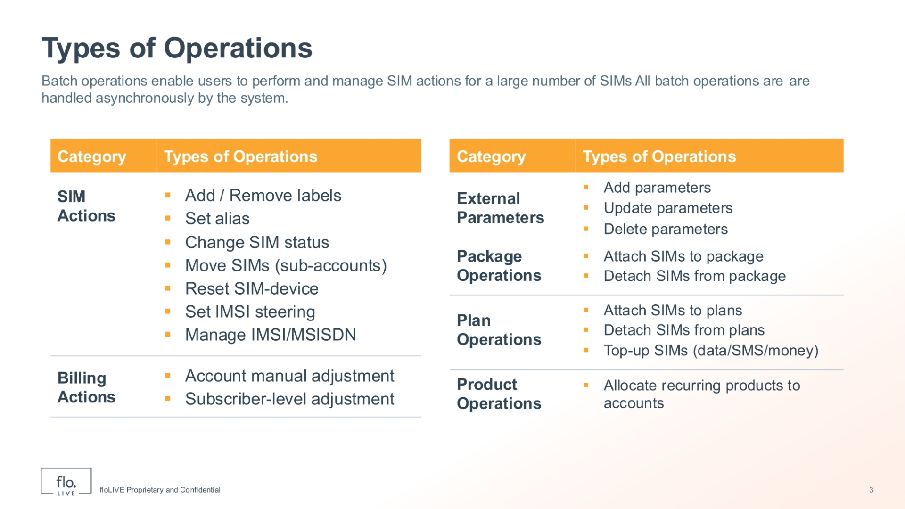
Notes:
CMP Batch operations support many types of actions. These include SIM actions, package operations, product operations, billing actions, plan operations, and external parameter updates. All of these operations are processed asynchronously, allowing the system to handle large volumes efficiently without interrupting user activity.

Slide 5
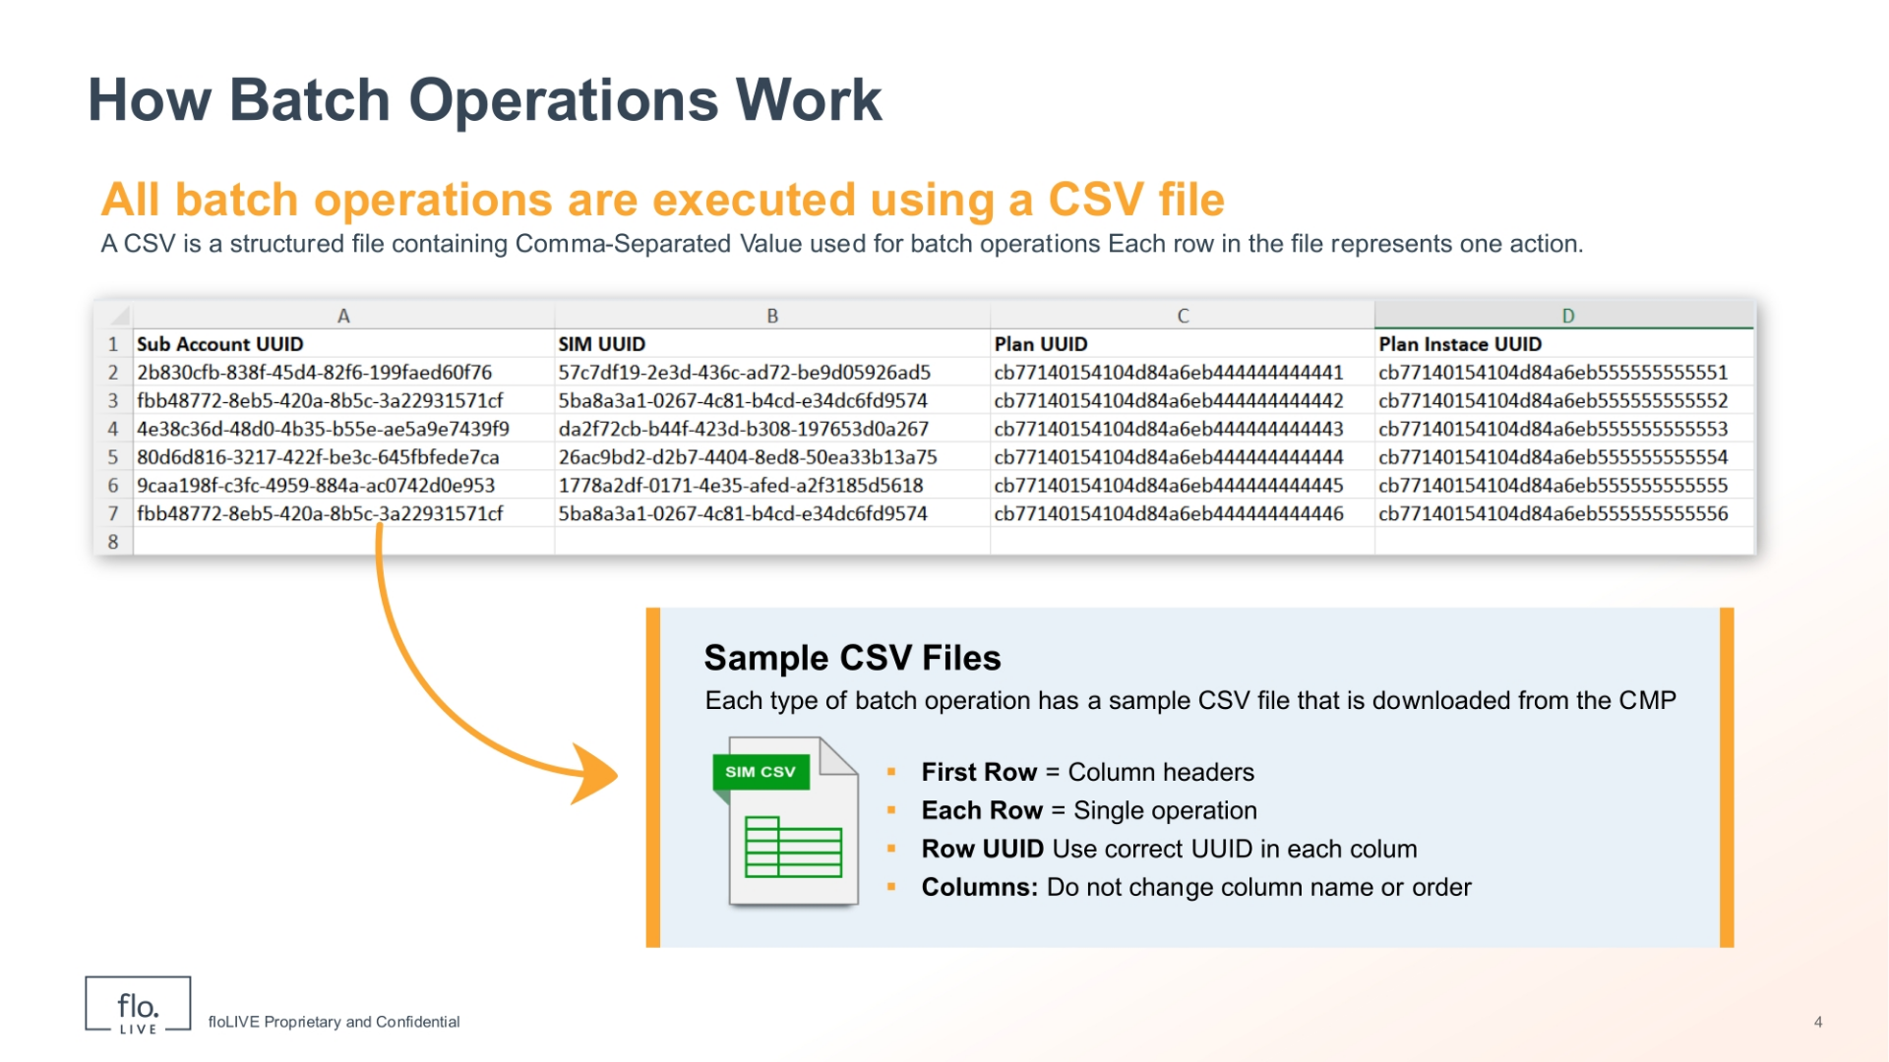
Notes:
All batch operations use a CSV file as input. Each row in the CSV file represents one action, and each column contains required data such as SIM UUID or Plan UUID. It is important to follow the template exactly, keep column names and order unchanged, and use valid UUID values. This ensures the system can correctly process each row without errors.

Slide 6
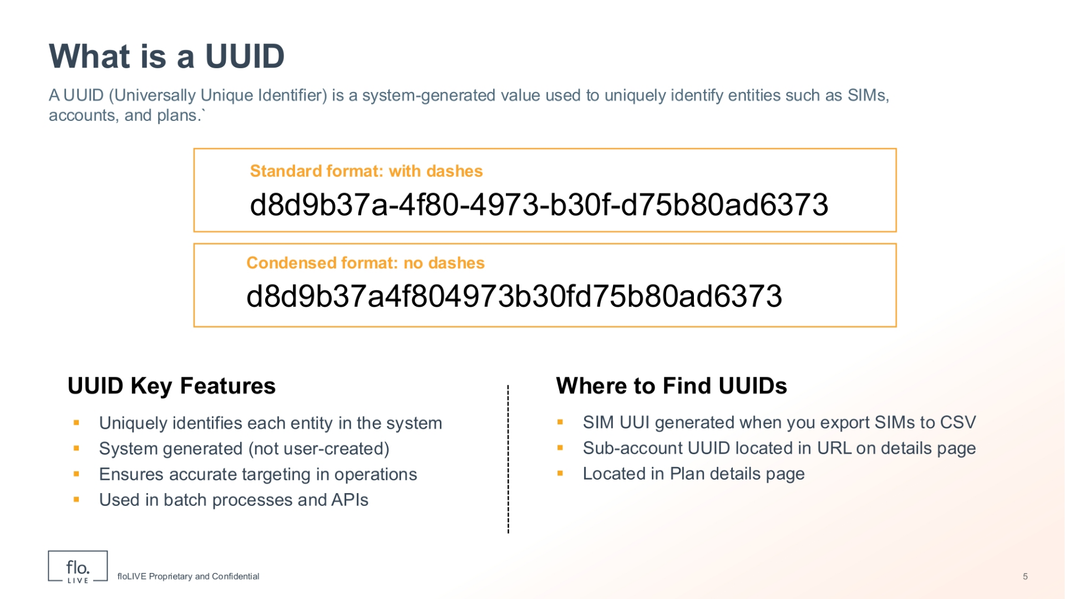
Notes:
A UUID is a system-generated identifier used to uniquely identify SIMs, accounts, plans, and other entities. Each UUID is unique, which ensures that every action is applied to the correct target. UUIDs are used in batch operations and APIs to provide accuracy and prevent confusion between records. You can find UUIDs in several places in the CMP. SIM UUIDs are available when you export SIMs to a CSV file. Sub-account UUIDs can be found in the URL of the account details page. Plan UUIDs are available on the plan configuration details page. Using the correct UUID from these sources is essential for successful batch operations.

Slide 7
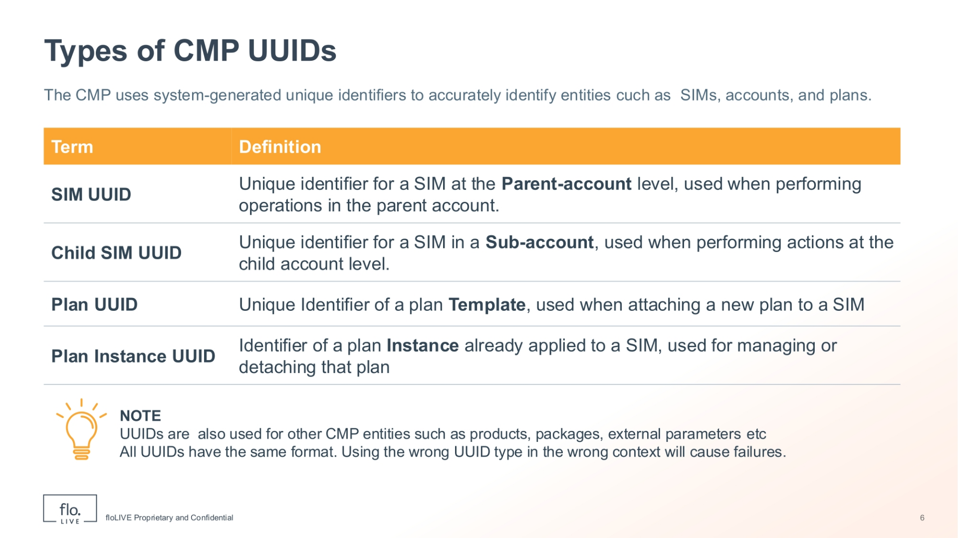
Notes:
The CMP uses different types of UUIDs, and each one is used for a specific entity. The SIM UUID identifies a SIM at the parent account level, while Child SIM UUID identifies a SIM in a sub-account. A Plan UUID represents a plan template, and Plan Instance UUID represents a plan already assigned to a SIM. Each UUID type is linked to a specific object in the system.

Slide 8
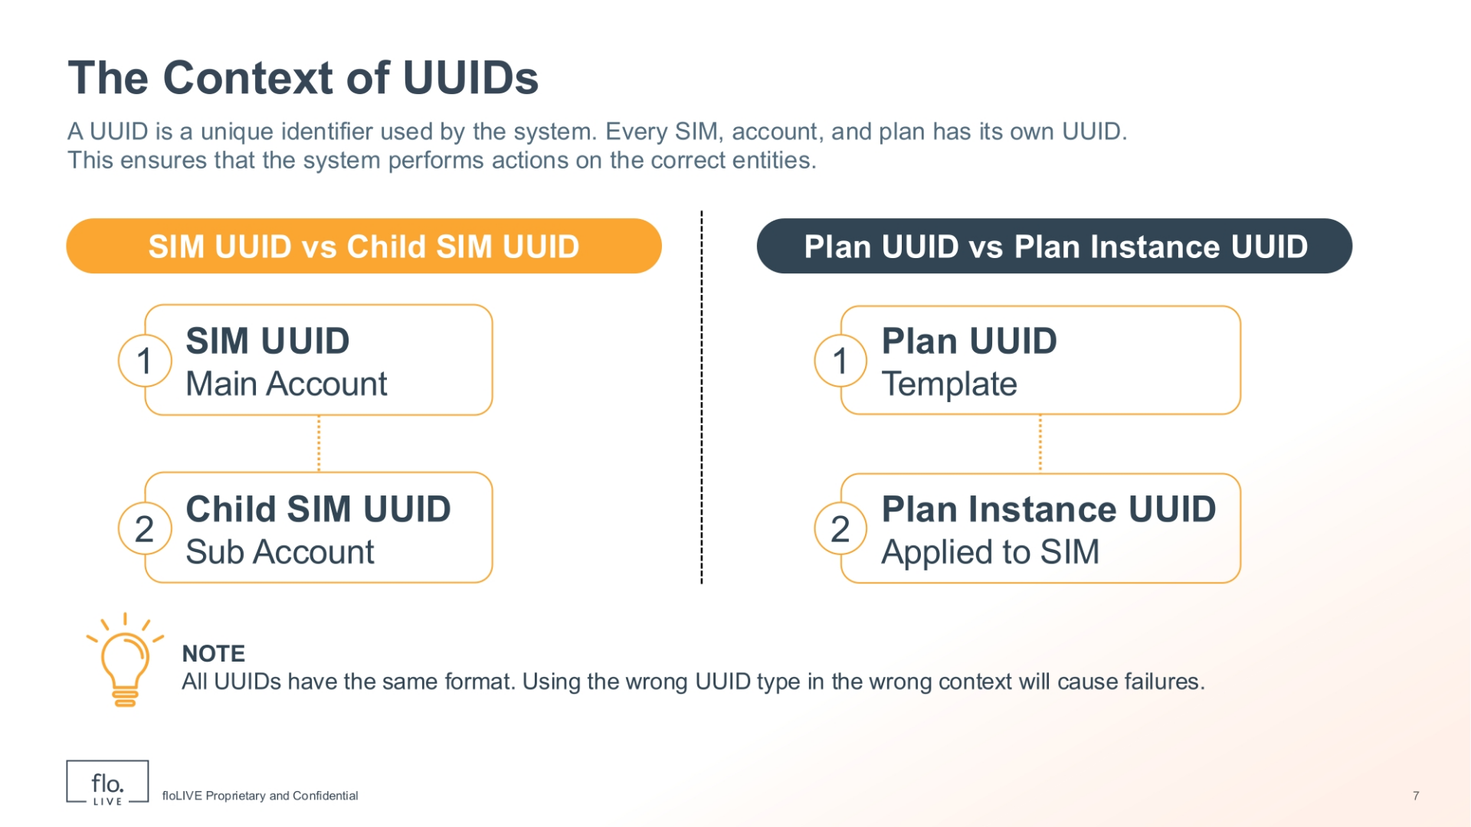
Notes:
When performing batch operations, it is important to use the correct UUID for the specific action. For example, when attaching a new plan, you must use a Plan UUID. When modifying or removing an existing plan, you must use a Plan Instance UUID. Using the wrong UUID type or wrong context will cause the batch operation to fail.

Slide 9

Notes:
Now let’s look at the batch operation workflow.

Slide 10
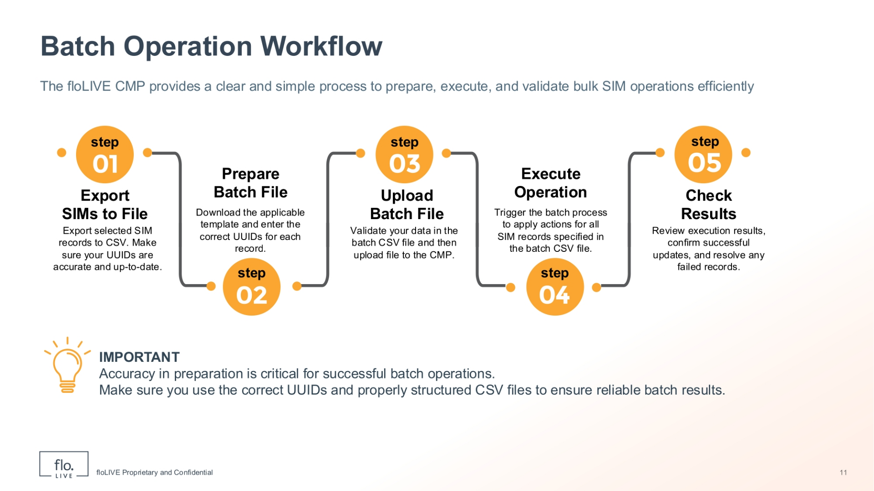
Notes:
This diagram shows the complete batch operation process, from preparing your data to executing the operation and checking the final results.

Slide 11
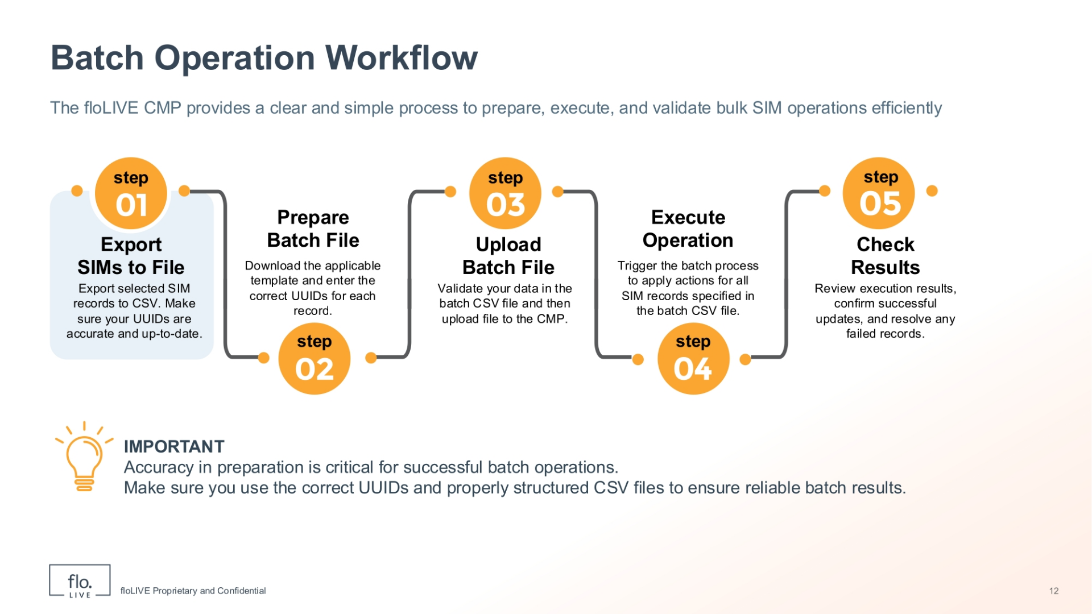
Notes:
The first step in creating a batch operation is to select your SIMs and then export the relevant SIM data into a CSV file. This ensures you have accurate and up-to-date identifiers, such as SIM UUIDs, which are required to perform batch operations correctly.

Slide 12
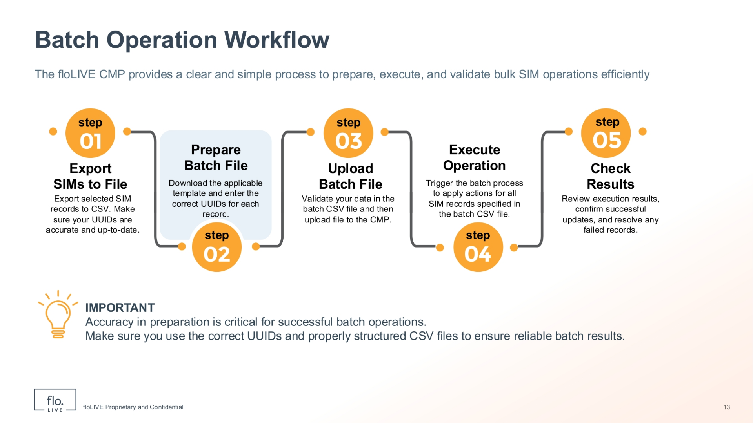
Notes:
The next step is to download the correct csv template from the Batch operations module, and populate the appropriate columns. Ensure all UUIDs are correct and that column names remain unchanged. Note that each row represents a single operation.

Slide 13

Notes:
Now you are ready to upload your batch CSV file to the CMP batch operation module. During this step, the system validates the file structure and prepares it for execution, making sure the data is aligned with the selected operation type.

Slide 14
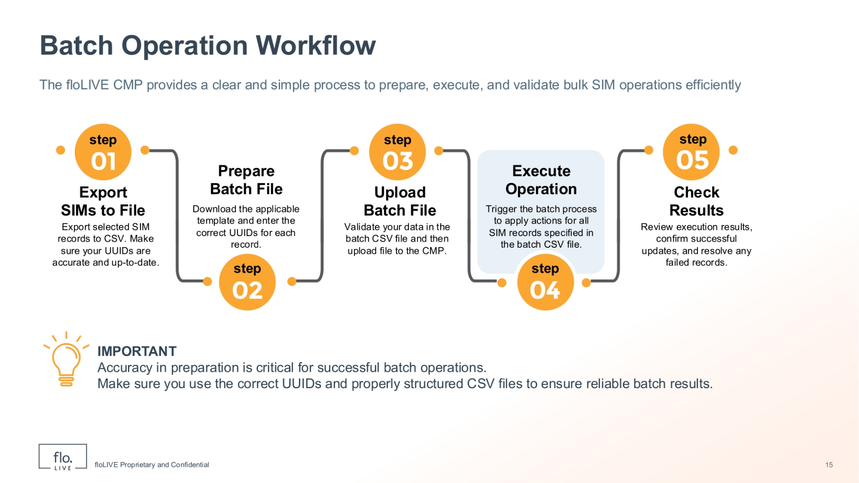
Notes:
When you file is succesfully uploaded, you can initiate the batch process. The system executes the requested actions asynchronously, allowing large volumes of SIM updates to be processed efficiently without manual intervention.

Slide 15
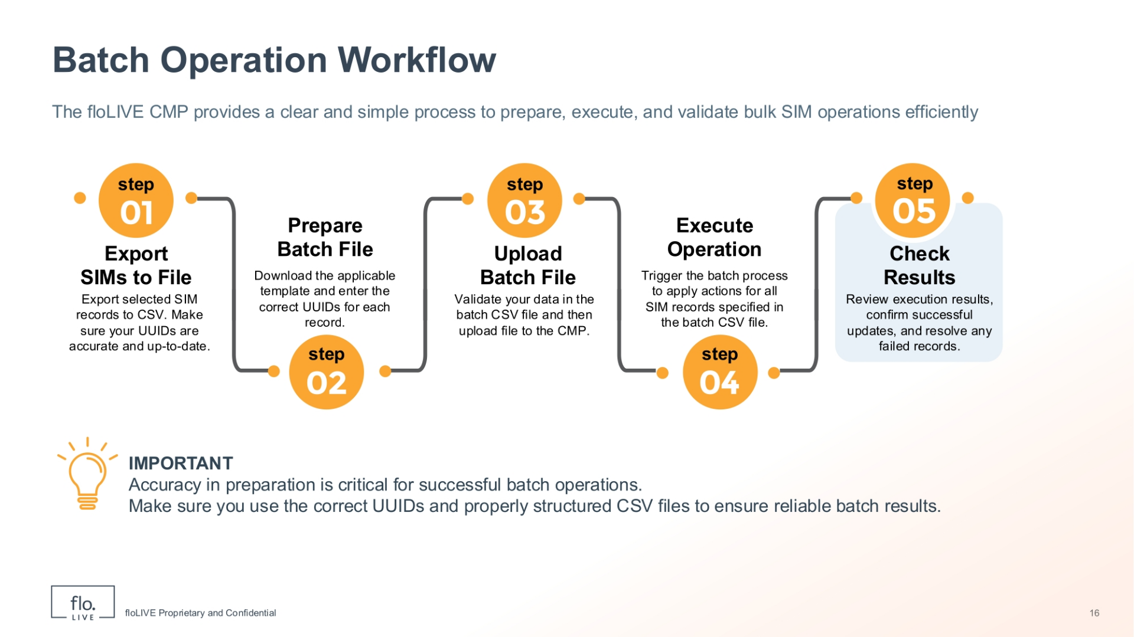
Notes:
After execution, review the operation results in the CMP Batch Operations table. You should validate successful updates, identify any failed records, and address errors if needed. This wil ensure all intended changes were applied correctly.

Slide 16

Notes:
Thank you for watching this video tutorial. For more information about the CMP system, make sure you visit our Knowledge-base that is accessible directly from the CMP Portal.

